Slide 1
Malicious URL Detector

Slide 2
Introduction
This project is aimed at detecting malicious website. A malicious website is a site that attempts to install malware onto your device (which usually allows it to gain full access to your device). This usually requires some action on your part, however, in the case of a drive-by download, the website will attempt to install software on your computer without asking for permission first.
We put forward a model to forecast whether a URL is malicious or benign websites, based on application layer and network characteristics. Machine learning techniques are used to build a classification model which is used to identify the malicious URLs.

Slide 3
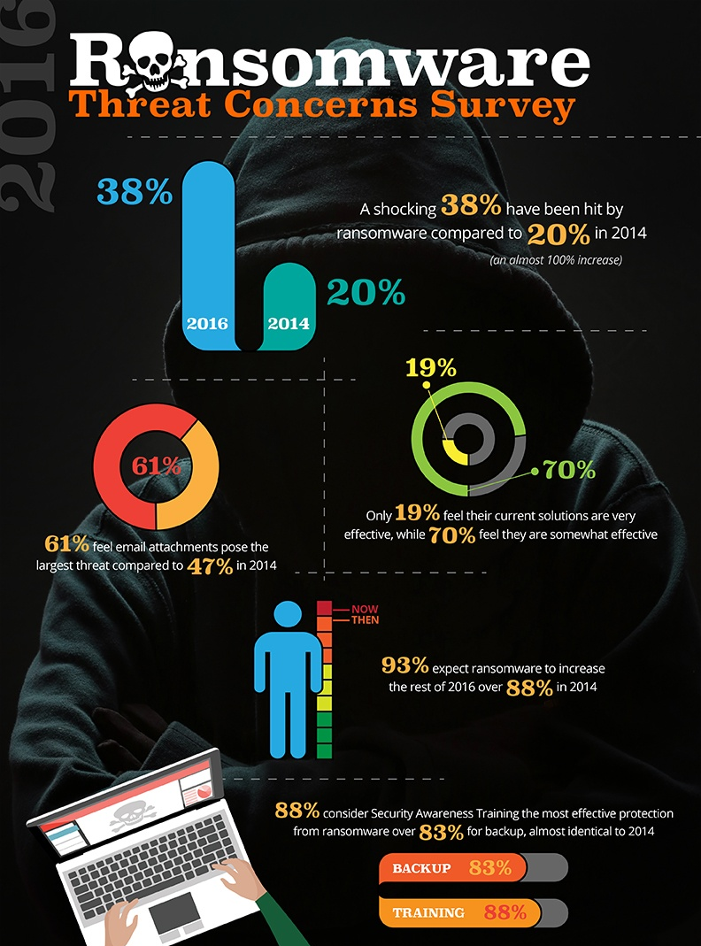
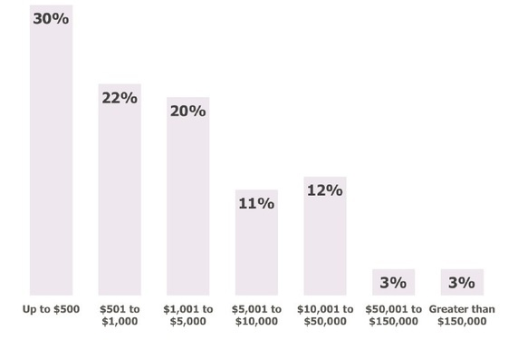
Attack Through Ransomware
Amounts Demanded by Ransomware Perpetrators
Malicious websites are a significant threat in the realm of cyber attacks and scams, and can be delivered to users through various means such as email, text message, pop-ups, or ads. These websites can lead to the download of malware, spyware, ransomware, and the compromise of accounts.

Slide 4
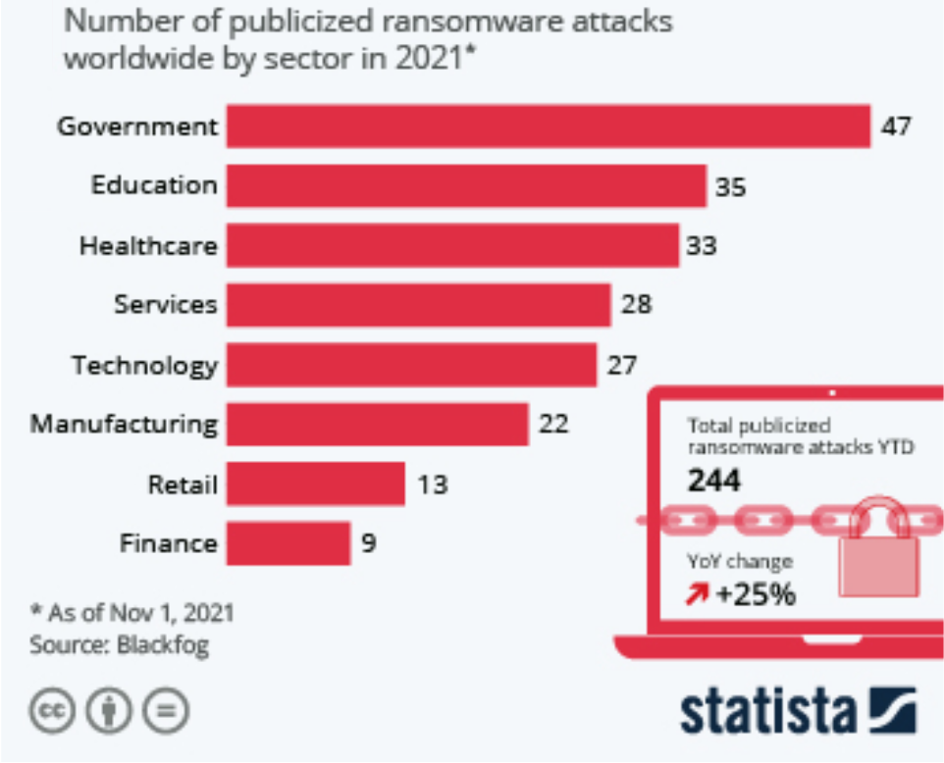
Our Audience
It appears that the majority of publicly addressed cyber attacks with ransom demands have occurred in the government sector, with a total of 47 instances.
Additionally, these types of attacks have also affected other sectors such as healthcare, education, and services. It is not clear from the information provided how frequently these attacks occur or how they have impacted the affected sectors.

Slide 5
Existing System
Blacklisting is a method of detecting malicious URLs that involves maintaining a list of known malicious URLs and checking new URLs against this list. When a new URL is visited, a database lookup is performed to determine if it is malicious or benign.
However, blacklisting can be limited in its effectiveness because it is difficult to maintain an exhaustive list of all malicious URLs, especially when new URLs can be easily generated daily.
This becomes a particular concern when attackers generate new URLs algorithmically, which can allow them to bypass blacklists. Despite these challenges, blacklisting remains a popular technique due to its simplicity and efficiency, and is used by many anti-virus systems.

Slide 6
Proposed System
Data Collection
Data Pre-Processor
Building Classifier
The data for this project is gathered from:
https://www.kaggle.com/datasets/xwolf12/malicious-and-benign-websites
The data is preprocessed by:
Interpolating
Identifying key features by correlation
One Hot Encoding
Select the algorithm that is best suited for the dataset.
Train and test the model with the dataset.

Slide 7
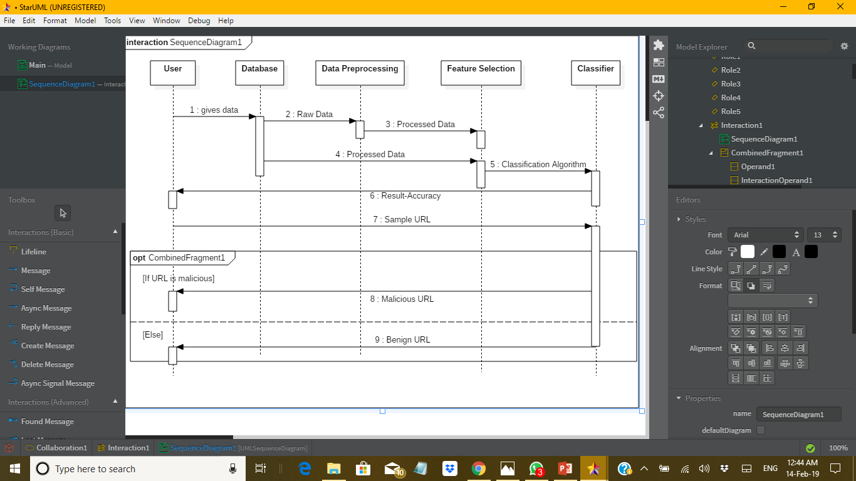

Slide 8
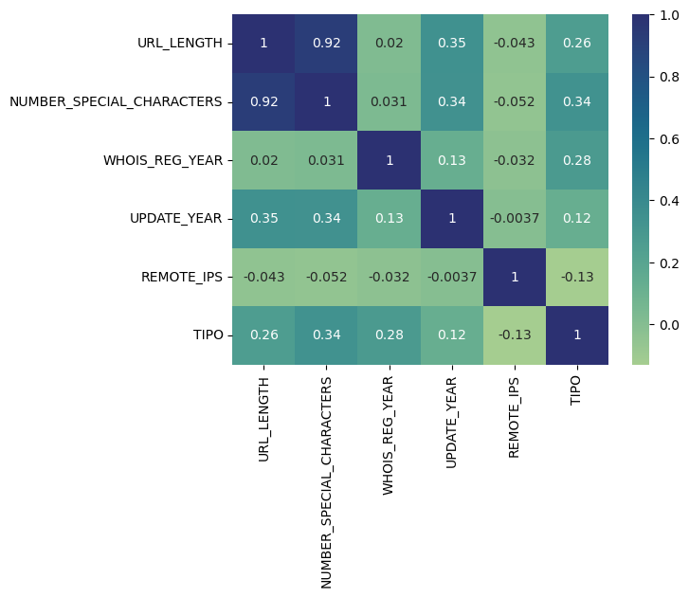
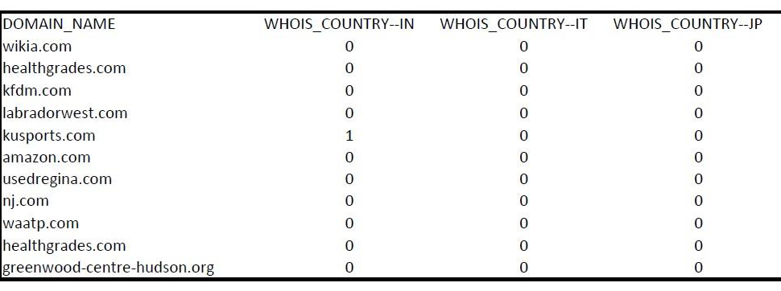
Data Preprocessing
To understand the relationship of features we generate a correlation matrix.
We perform One-Hot encoding to enhance the model building

Slide 9
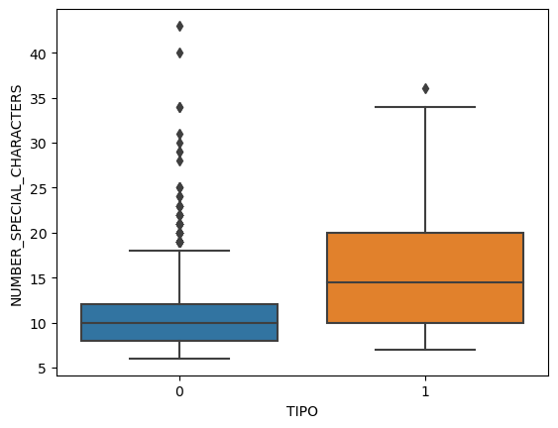
Box plot

Slide 10
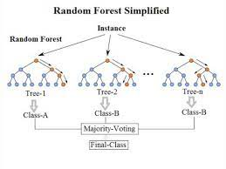
Algorithm
It consists of a large number of individual decision trees that operate as an ensemble.

Slide 11
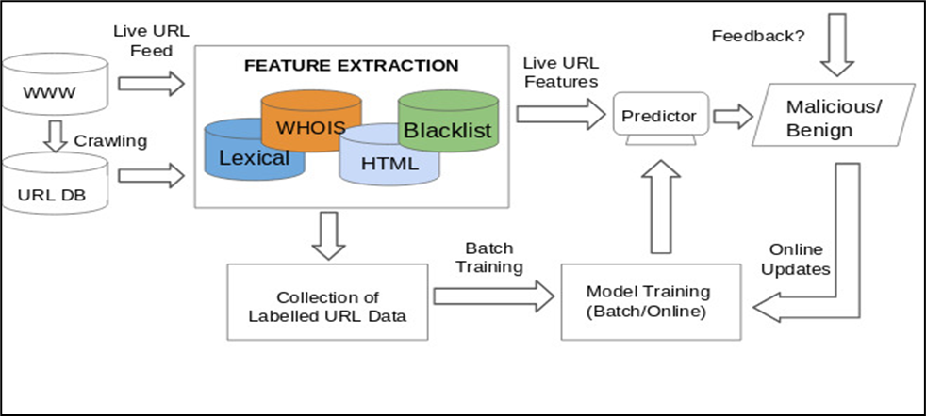

Slide 12
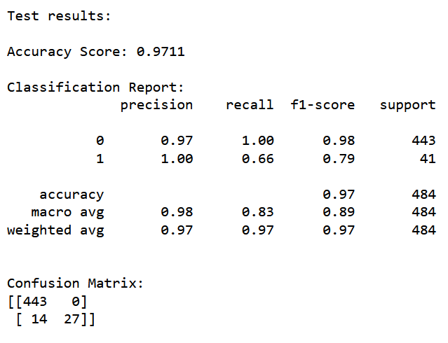
Results

Slide 13
References
[1] P. Varaprasada Rao, S. Govinda Rao, P. Chandrasekhar Reddy, B. S. Anil Kumar, G. Anil Kumar, “Detection of Malicious uniform Resource Locator”, IJRTE ISSN: 2277-3878 (Online), Volume-8 Issue-2, July 2019
[2] P. Prakash, M. Kumar, R. R. Kompella, M. Gupta, "Phishnet: predictive blacklisting to detect phishing attacks", INFOCOM 2010 Proceedings IEEE., pp. 1-5, 2010.
[3] P. de las Cuevas, Z. Chelly, A. Mora, J. Merelo, A. Esparcia-Alcazar, "An improved decision system for URL accesses based on a rough feature selection technique" in Recent Advances in Computational Intelligence in Defense and Security, Springer, pp. 139-167, 2016.
[4] J. Ma, L. K. Saul, S. Savage, G. M. Voelker, "Identifying Suspicious URLs: An Application of Large-scale Online Learning", Proceedings of the 26th Annual International Conference on Machine Learning, pp. 681-688, 2009.
[5] L. OpenDNS, “Phishtank: An anti-phishing site,” Online: https://www. phishtank. com, 2016.
[6] Y. Alshboul, R. Nepali, and Y. Wang, “Detecting malicious short urls on twitter,” 2015.

